Slide 1
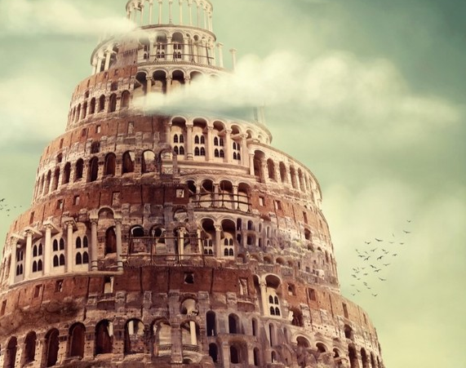
EVANGELISTIC SERMON 2 “COME OUT OF HER”
REVELATION 18:4

Slide 2
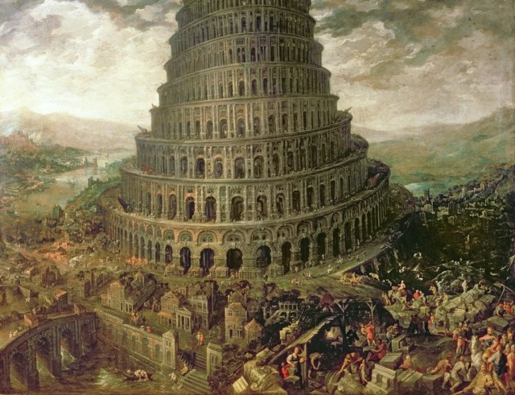
Introduction
What is this Babylon that John the Revelator writes about.
Is this the Babylon that the Luthers and Calvins saw in the 16th century?
Notes:
The purpose of this material is to expand the Traditional thought pattern of the Text to show that Babylon today includes, the amalgam of evil that is moving like a sludge in CHRISTENDON.

Slide 3
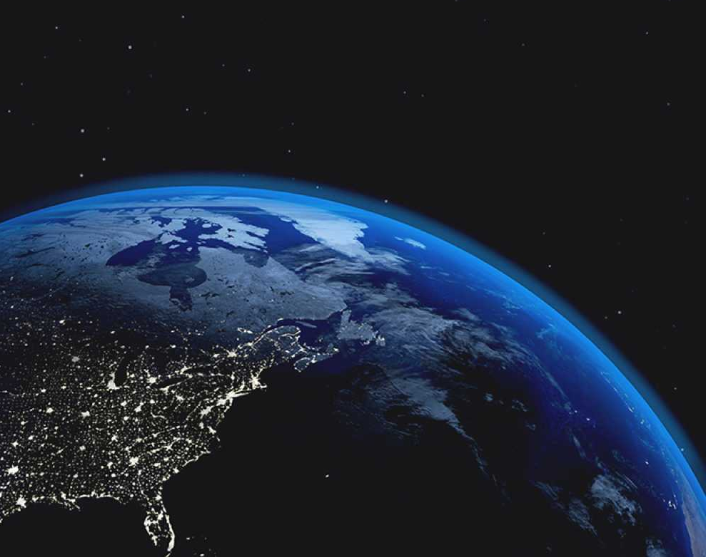
What is happening in the World Today?
What are we seeing in America?
Who ever thought a democratic law-abiding America can be reduced to tools in the hands of only two individuals in that country?

Slide 4
Based on these occurrences in the world
Is it possible an age old prophecy enshrined in the book of Revelation becomes relevant and move to its fulfilment in a world living in the expectancy of the New World Order?
Is it possible too that this prophecy of Revelation 18:4, move to its fulfilment where Strategic Development Goals (SDG) and Nations’ Egocentrism and inward economic practices interspersed with America’s Trade War and high Tariffs which have reduced nations to the state of beggars are the only concerns of the world?
Is it also possible that this prophecy will move to its fulfillment where global Warmings, Climatic Changes, the needed green revolution are the top items on the agenda of Interntional World Leadership Summits?

Slide 5
Based on these occurrences in the world
Is it possible the prophecy will find its fulfilment in this world of Youth addictions to drugs, lotteries and the get rich quick sakawa juju craze?
Is it possible the prophecy to call the world our of Babylon find its fulfilment in a world measured with modern day Spiritism?
Notes:
These are tough questions that need serious answers.

Slide 6
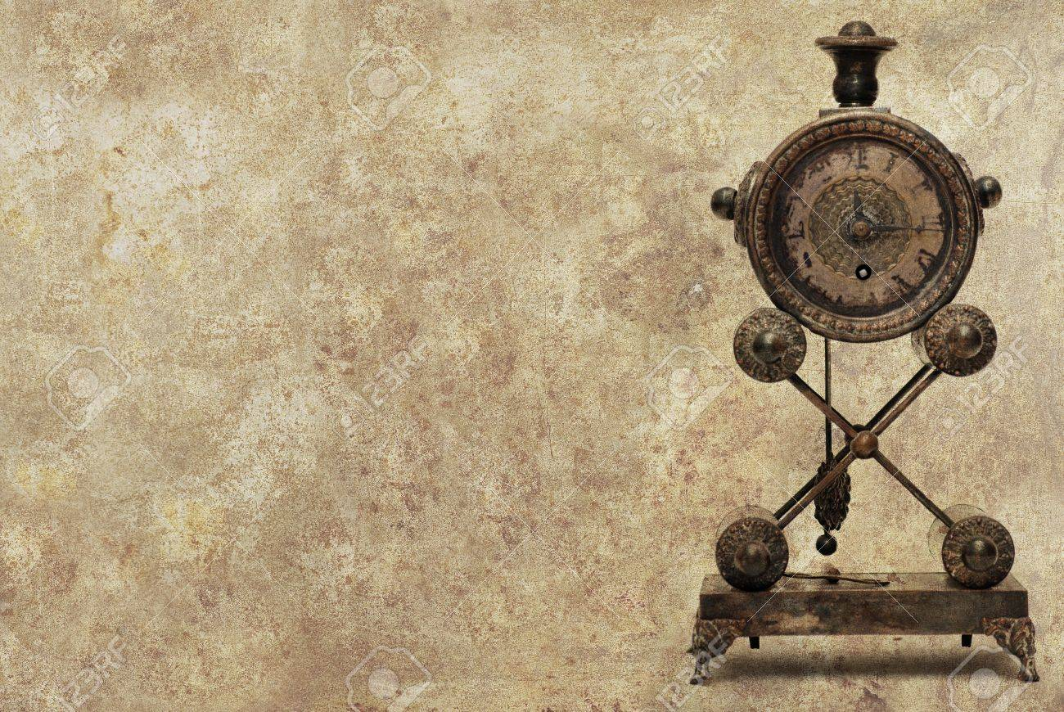
The world of the Yester-Years

Slide 7
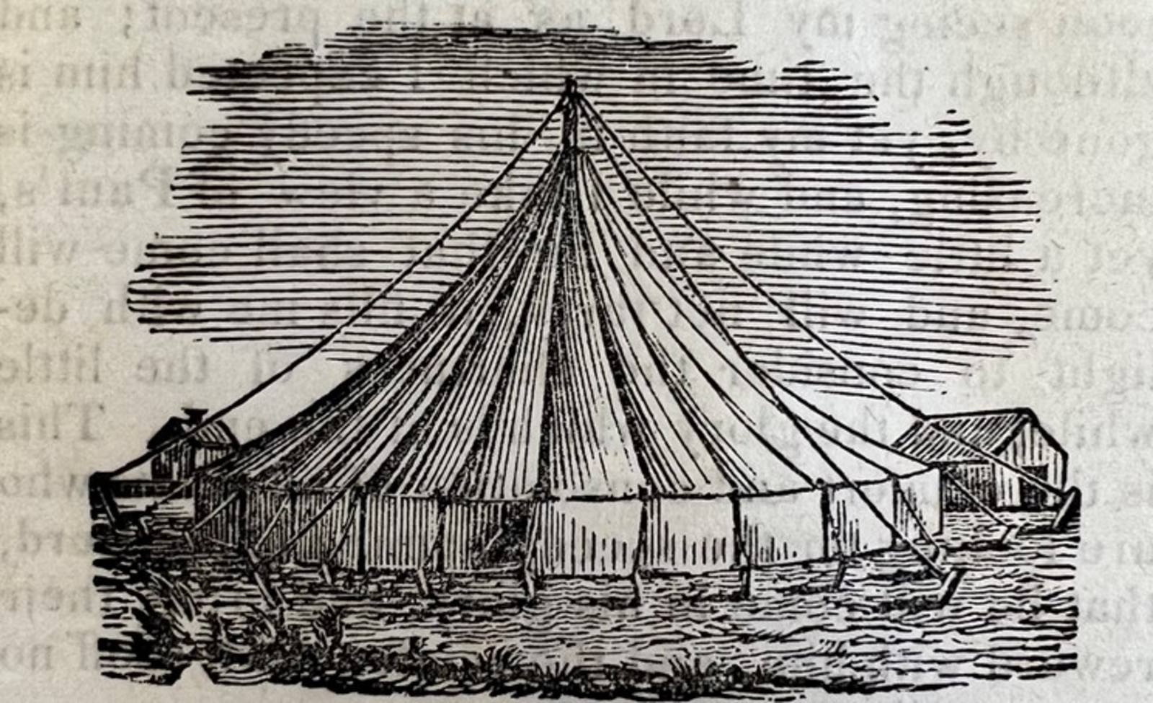
Everybody, every where who has done any evangelism today would agree with me that, the world of today is seriously different from the world of the yester-years.
Notes:
All sort of things are competing for the time of the people of today. Science and Technology that has made the world a global village with the internet services it offers give people free access to anything that bewitches the soul and mesmerizes and benumbs the mind to give people no time to listen to “Thus saith, the LORD.”

Slide 8
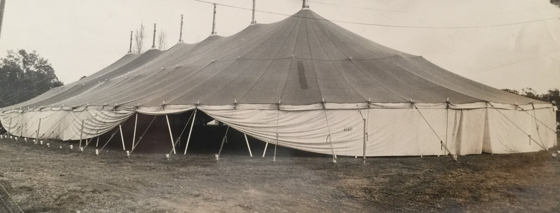
The open air evangelistic Campaigns that were conducted in the Tent Cathedrals in the days of the H.M. Richards (Snr), C.D Brooks, C. D Henrys, E.E Clevelands and the Top-Notch powerful evangelists this world has produced in the days gone by is irrelevant today!
Notes:
No body is interested in open air crusades unless it is the charismatic glossolalia miracle crusades clothed in falsehood.

Slide 9

So Evangelists are tottering on tough grounds as they try to get the world’s attention to understand the identity of the apostate Babylon and the need to “come out” of her (Rev. 18:4).

Slide 10
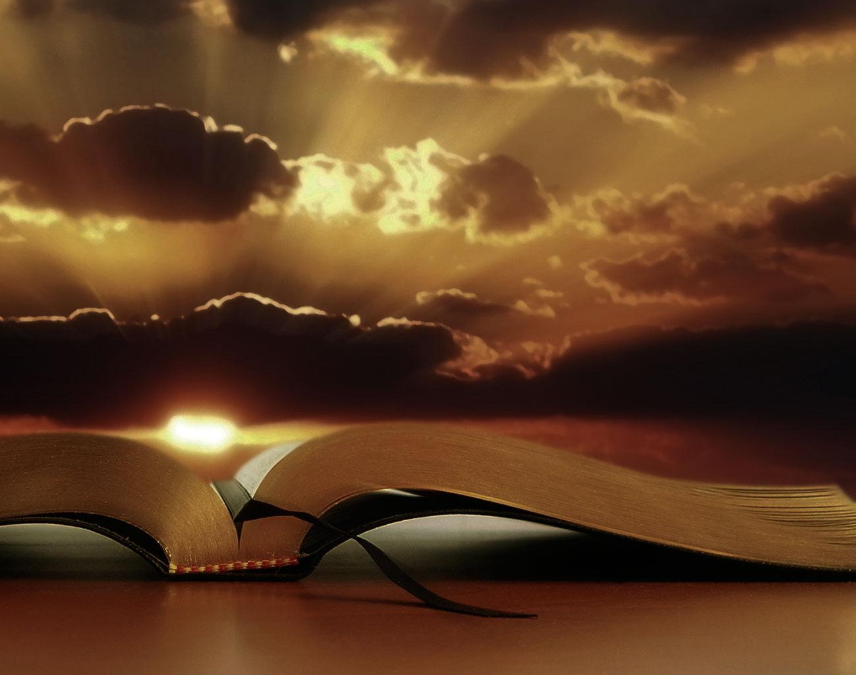
The World Of God Will Move Victory To At All Costs!

Slide 11

The word of God is not culturally conditioned. It is as relevant today as it was in the days of the Caesar Worship and the Emperor persecutions.

Slide 12
That was the state of affairs of the Days of John the Revelator. Jesus revealed to John the Beloved apostle, through the angel sent from heaven to write down to the world of today that, Babylon the apostate religion has done so much to let the world drink the wine of her filthiness and so stand the risk of damnation. Unless it comes out of her influence, wantonness and idle luxury, there is a certain and sure end!

Slide 13
Babylon of (Revelation 18) is “arraigned before the bar of divine justice on five counts
Pride and arrogance
Materialism and luxury
Adultery
Deception
Persecution (Rev. 18:2, 3, 5, 7, 21, 24)” (SDA Bible Commentary Vol. 7, RH Pub. 1980 p. 86)
Notes:
Whatever the case, what the Lord has written about Babylon would come to pass and her destruction would be certain. Because, Babylon is guilty of the crimes stated above.

Slide 14
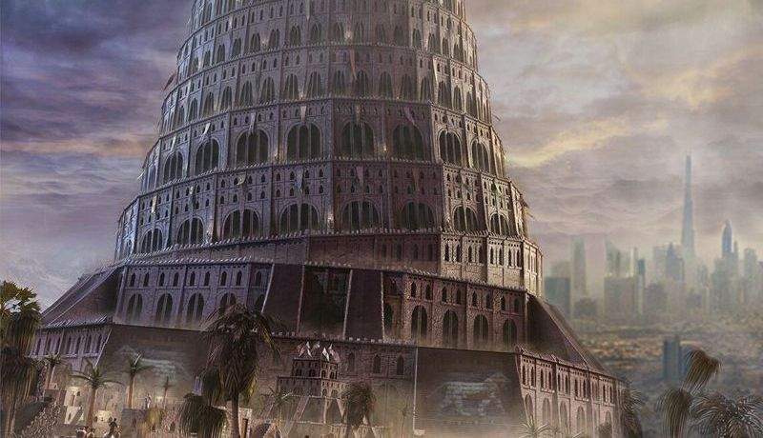
What is Babylon The Great?

Slide 15

“Literal Babylon was the great city of the ancient times. It was built by Nimrod (Gen. 10:8). “From the days of Babel, the city of Babylon has been the representative of organized opposition to the purposes of God on earth. A city is a highly organized and integrated association of human beings. How appropriate is ‘Babylon the great’ as a prophetic symbol for the organized universal, apostate religious organization”
(ibid, pg. 859).

Slide 16
If this is the Babylon the angel warns the world to be wary of, then the “punishment of Babylon, the United apostate religious organization on earth takes place under the seventh plague (Rev. 16:19, Rev. 17:1, 5, 16)” (Ibid, pg. 861). Thus this is a divine punishment of which no human being would have a hand in it.

Slide 17
Under the divine command, mystical Babylon made up of three parts:
The papacy
The apostate Protestantism
And modern day spiritism
Would receive the divine punishment.

Slide 18
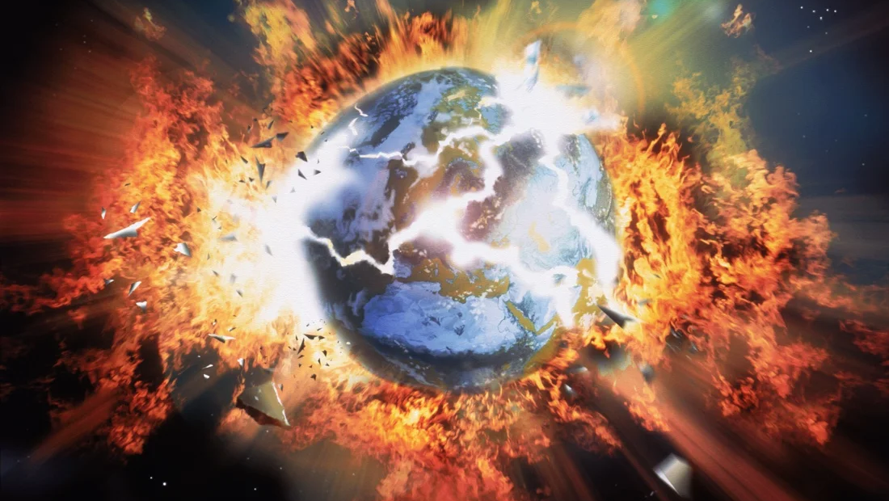
What is going to happen at the end of time?

Slide 19
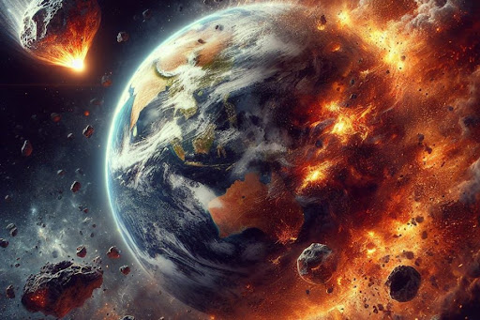
The Mystical Babylon’s three entities mentioned above led by the papacy would unite to hate the people of GOD, who would stand by Him to hold on to “Thus Saith the LORD”! At the last moments of the world’s history, they would enact a death decree to eradicate the people of God. This will happen unless the LORD cut short the time and finishes it in righteousness
(Romans 9:28).
Notes:
Until then, the sequence of events would follow as John was informed

Slide 20
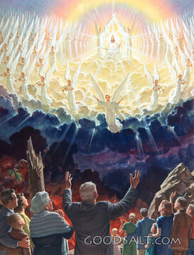
As the appointed moment arrives, and the wicked from the 3-tiered religious union rush to annihilate God’s people, the voice of God would declare “It is done!” (Rev. 16:17).
This declaration would terminate the agonizing time of the people of God. Their crisis is recorded in (Jeremiah 30:5-7). The LORD would deliver His saints as He ushers in the 7th plague.

Slide 21
Some of the events that would characterize the outpouring of the Seventh plague include:
The greatest earthquake since the world began would strike, amid thunder and lightning
(Rev. 16:18).
Cities of the Earth fallings apart (Rev. 16:18).
The 3-tiered religious union of papacy, apostate Protestantism and spiritism would break apart
(Rev. 16:19).
Islands would disappear
(Rev. 16:20).
Great hail the weight of the talent would strike men on earth (Rev. 16:21).
Men would blaspheme the name of God because the 7th plague would be exceedingly great (Rev. 16:21).

Slide 22

The reaction of the sons of men

Slide 23
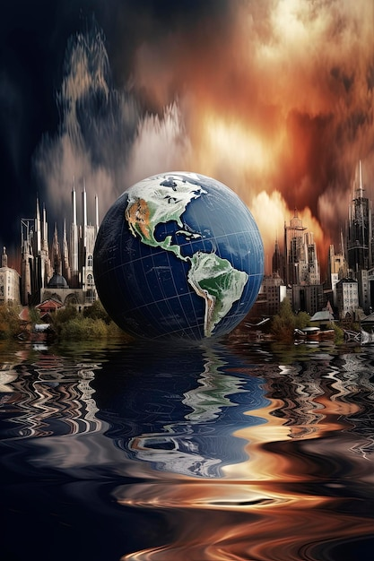
After that great earthquake the apostate religious amalgam falls apart.
The political forces of the world that also hold the intention of destroying the people of God also break up.
And there will be terrible anxiety among the people of the world as God steps in to save His people.
Then they would begin to fight among themselves.

Slide 24

There will be carnage as people would react to the fact that, they had been deceived!
Instead of people being taught the truth about heaven’s wrath against the pervasive false messages that were delivered in Christendom, they were taught sugar-coated messages, so they were imprisoned in falsehood.
For that matter they attacked the religious leaders.

Slide 25
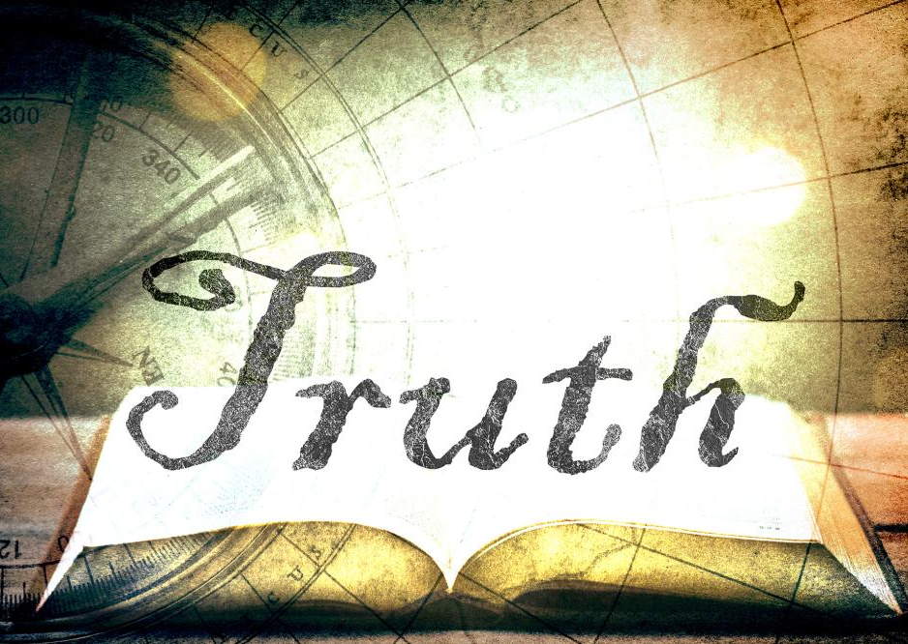
Today as we listen to this message, truth is fallen in the streets (Isaiah 59: 14-17). “Thus filled with fury the hosts of the earth turn upon their leaders and upon one another. The weapons with which they had purposed to slay the saints were used to destroy their leaders. There will be strife and bloodshed every where” (Ibid. pg. 847).

Slide 26
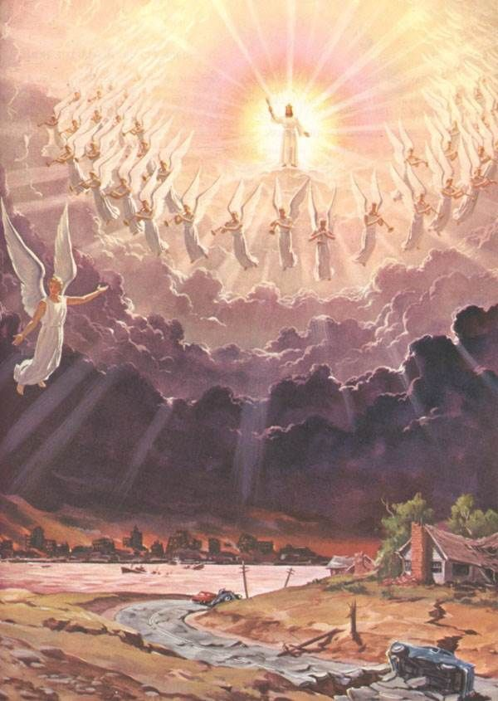
Conclusion
It is amid this cacophony of sounds and confusion that Jesus appears in the blaze of His glory to take His wedded bride, the church home. (Rev. 6:14-17) states that the people would run helter skelter but no one could save them.

Slide 27
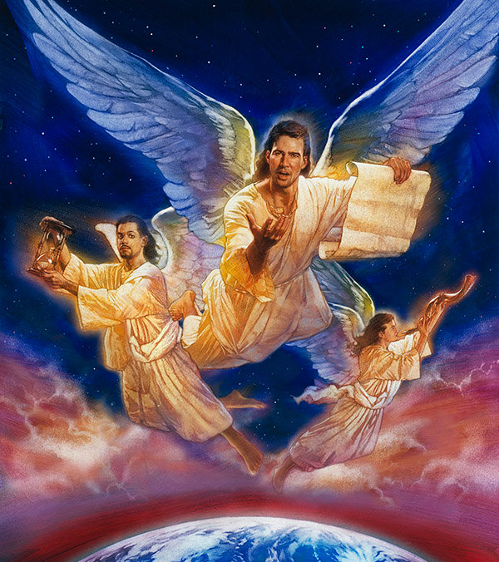
It is because of the nearness of this catastrophic and cataclysmic event that the lost would go through, that is why the angel of God wants this message to be delivered, that those genuine innocent people would come out of Babylon.
God wants the church that listens to Him to preach so that the innocent people in Babylon could run out of it before it is too late.

Slide 28
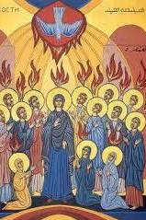
Therefore, come out of the glossolalia falsehood. Yes, come out of the secret rapture non-biblical doctrine. Because Jesus is coming soon! Come out of her, the Babylon of inky dark false doctrines! Come out of her! Come out of her, my people!

